Slide 1



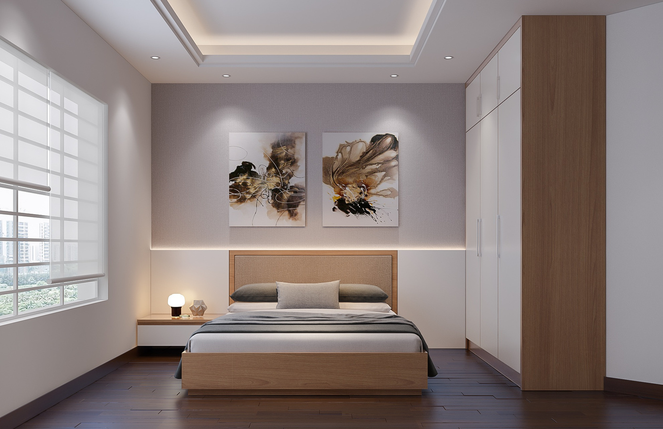



ModifAI
Project Update 5
Overview of progress and future plans for our AI-powered interior decor app

Slide 2






Team Introduction for ModifAI Project Update 5
Akram Hossain Apu Khan – 2231090642
Mehedi Hasan Dip – 2232167042
Together, we are transforming interior decor through AI technology.
Hacibull Hashan Tosher – 2111626642

Slide 3


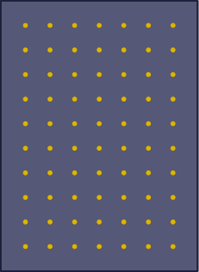

Key Concepts Behind ModifAI's Interior Decor Revolution
AI-driven insights provide personalized decor options for every taste.
Efficient algorithms streamline the decor selection process, saving users time.
ModifAI fosters creativity by offering inspired design solutions tailored to individual needs.
User-friendly interface ensures a seamless experience for all users.

Slide 4
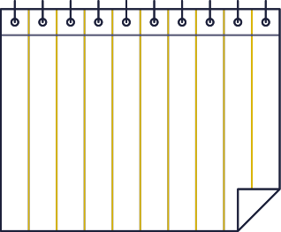
This Week's Progress
New Authentication System
Enhanced Firestore Integration
Updated Chat Features
Ongoing User Data Issues
We have successfully implemented Firebase authentication, enhancing the security and user experience of ModifAI. This feature allows users to create accounts and log in securely, ensuring data protection.
The integration of Firebase Firestore has been completed, allowing for efficient data storage and retrieval. This improvement streamlines information management within the app, making it more responsive and reliable.
We have updated the user-to-user chat system, providing a more interactive experience for users. This enhancement encourages communication and collaboration among users, fostering a strong community.
Currently, we are facing challenges fetching user data for the user-to-user homepage. Addressing this issue is crucial to ensure that users can access their information seamlessly and engage fully with the platform.

Slide 5


Current Challenges in ModifAI
Addressing user data fetching issues is crucial for enhancing user experience in our interior decor app.
Data Fetching Errors
Impact on Users
Solutions in Progress
We are encountering significant challenges in fetching user data, which affects functionality.
These issues hinder user experience, making it difficult for users to access personalized decor suggestions.
Our team is actively working on resolving these errors to ensure a seamless experience for all ModifAI users.

Slide 6

Next Steps for Enhancing ModifAI's Functionality and Performance
Fix user data fetching problem
Successfully connect user-to-user chat
Enhance user interface for better usability
Incorporate user feedback for improvements
Explore additional AI features for personalization
These steps aim to improve user experience and app reliability.

Slide 7



Progressing Towards User-Friendly Experience
ModifAI is making significant progress with the introduction of new features and improvements. Our focus on creating a personalized and efficient user experience drives us forward. As we continue to enhance our AI capabilities, we aim to offer seamless decor suggestions tailored to individual preferences. Future work will include incorporating more innovative features and refining the overall user interface to ensure that every interaction is enjoyable and intuitive.

